Slide 1
NEWTON SCHOOL SQL ADVANCED CAPSTONE PROJECT
RCB IPL Performance Analytics &
2017 Mega Auction Strategy
Comprehensive Empirical Diagnostics, Venue Dynamics, and Squad Reconstruction Blueprint
Author: Sports Data Analyst | Database: ipl_db (Seasons 2008–2016)

Slide 2
EXECUTIVE BRIEF
Problem Statement & Strategic Mandate
1. Context & Objective
Hired as the sports data analyst for Royal Challengers Bangalore (RCB) ahead of the pivotal 2017 Mega Player Auction. The primary objective is to analyze 9 seasons of historical IPL data (2008–2016) to uncover root causes of tournament underperformance and design a championship-winning roster strategy.
2. The Core Paradox
RCB boasts the most destructive batting triumvirate in T20 history (Virat Kohli, AB de Villiers, Chris Gayle), regularly setting world scoring records. Despite reaching three IPL finals (2009, 2011, 2016), the franchise has never won the trophy.
3. Analytical Scope
Deliver empirical diagnostics addressing: (1) Toss & Chasing impact across stadiums, (2) Chinnaswamy home fortress vulnerability, (3) Phase-wise bowling degradation (especially death overs), and (4) Optimal all-rounder and pace recruitment for 2017.

Slide 3
DATA ARCHITECTURE
Data Overview & Dataset Dimensions
1. Dataset Scope & Depth
The dataset contains exhaustive delivery-level and match-level records spanning 9 complete seasons (2008 to 2016). Total records: 577 matches, 136,590 deliveries (Ball_by_Ball), 133,097 scoring events, 7,469 extra-run instances, and 6,727 dismissals.
2. Core Entities Tracked
Entities include 469 registered players, 13 IPL franchises, 35 international and domestic cricket stadiums, 14 classified bowling skills, 2 batting hands, and 9 dismissal types.
3. Data Quality & Cleansing
Strict cricket scoring hygiene applied: (1) Run outs, retired hurt, and obstructing field dismissals removed from bowler wickets; (2) Wides excluded from batsman balls faced; (3) Multi-table left joins applied to capture unearned extras.

Slide 4
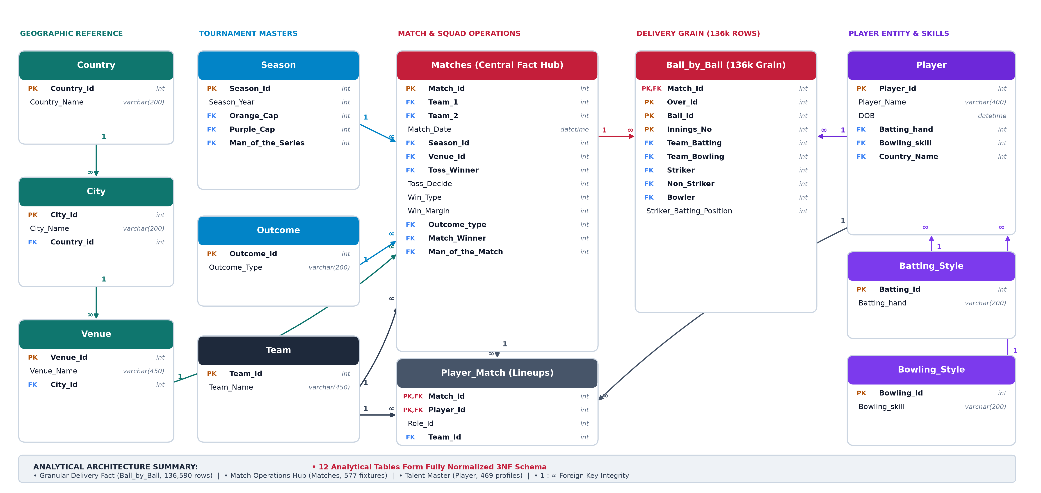
DATA ARCHITECTURE & SCHEMA
Database Schema & Analytical Data Model

Slide 5
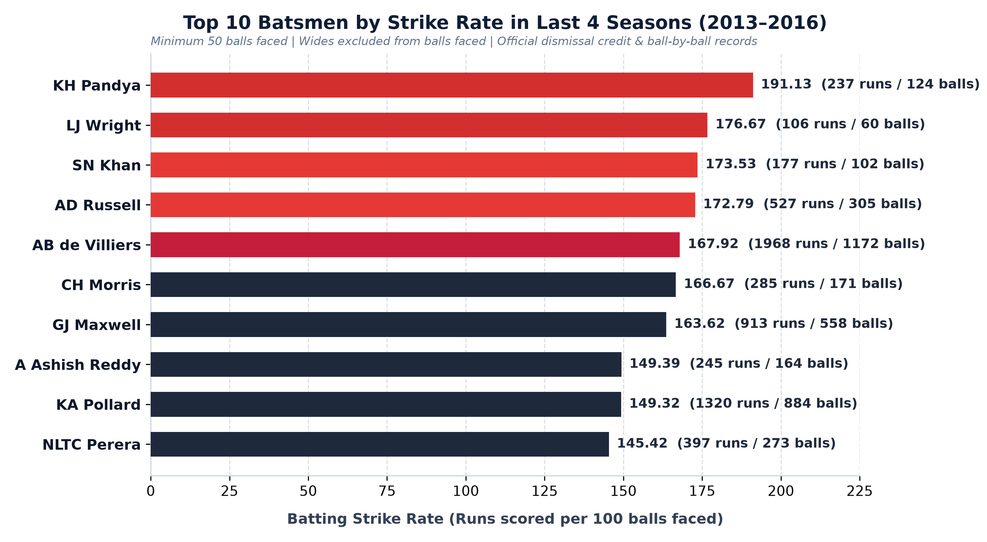
BATTING VELOCITY ANALYSIS
Top 10 Batsmen by Strike Rate (2013–2016)
• Power Hitters Setting Modern Tempo
Krunal Pandya (191.13 SR) and Luke Wright (176.67 SR) top the strike rate charts for batsmen facing >= 50 legal balls.
• High-Volume Outlier
AB de Villiers is the standout high-volume powerhouse, striking at 167.92 across an extraordinary 1,172 balls faced.
• Strategic Tactical Takeaway
T20 batting requires dynamic finishing over pure accumulator pacing; lower-order strike rates above 170 swing close finishes.

Slide 6
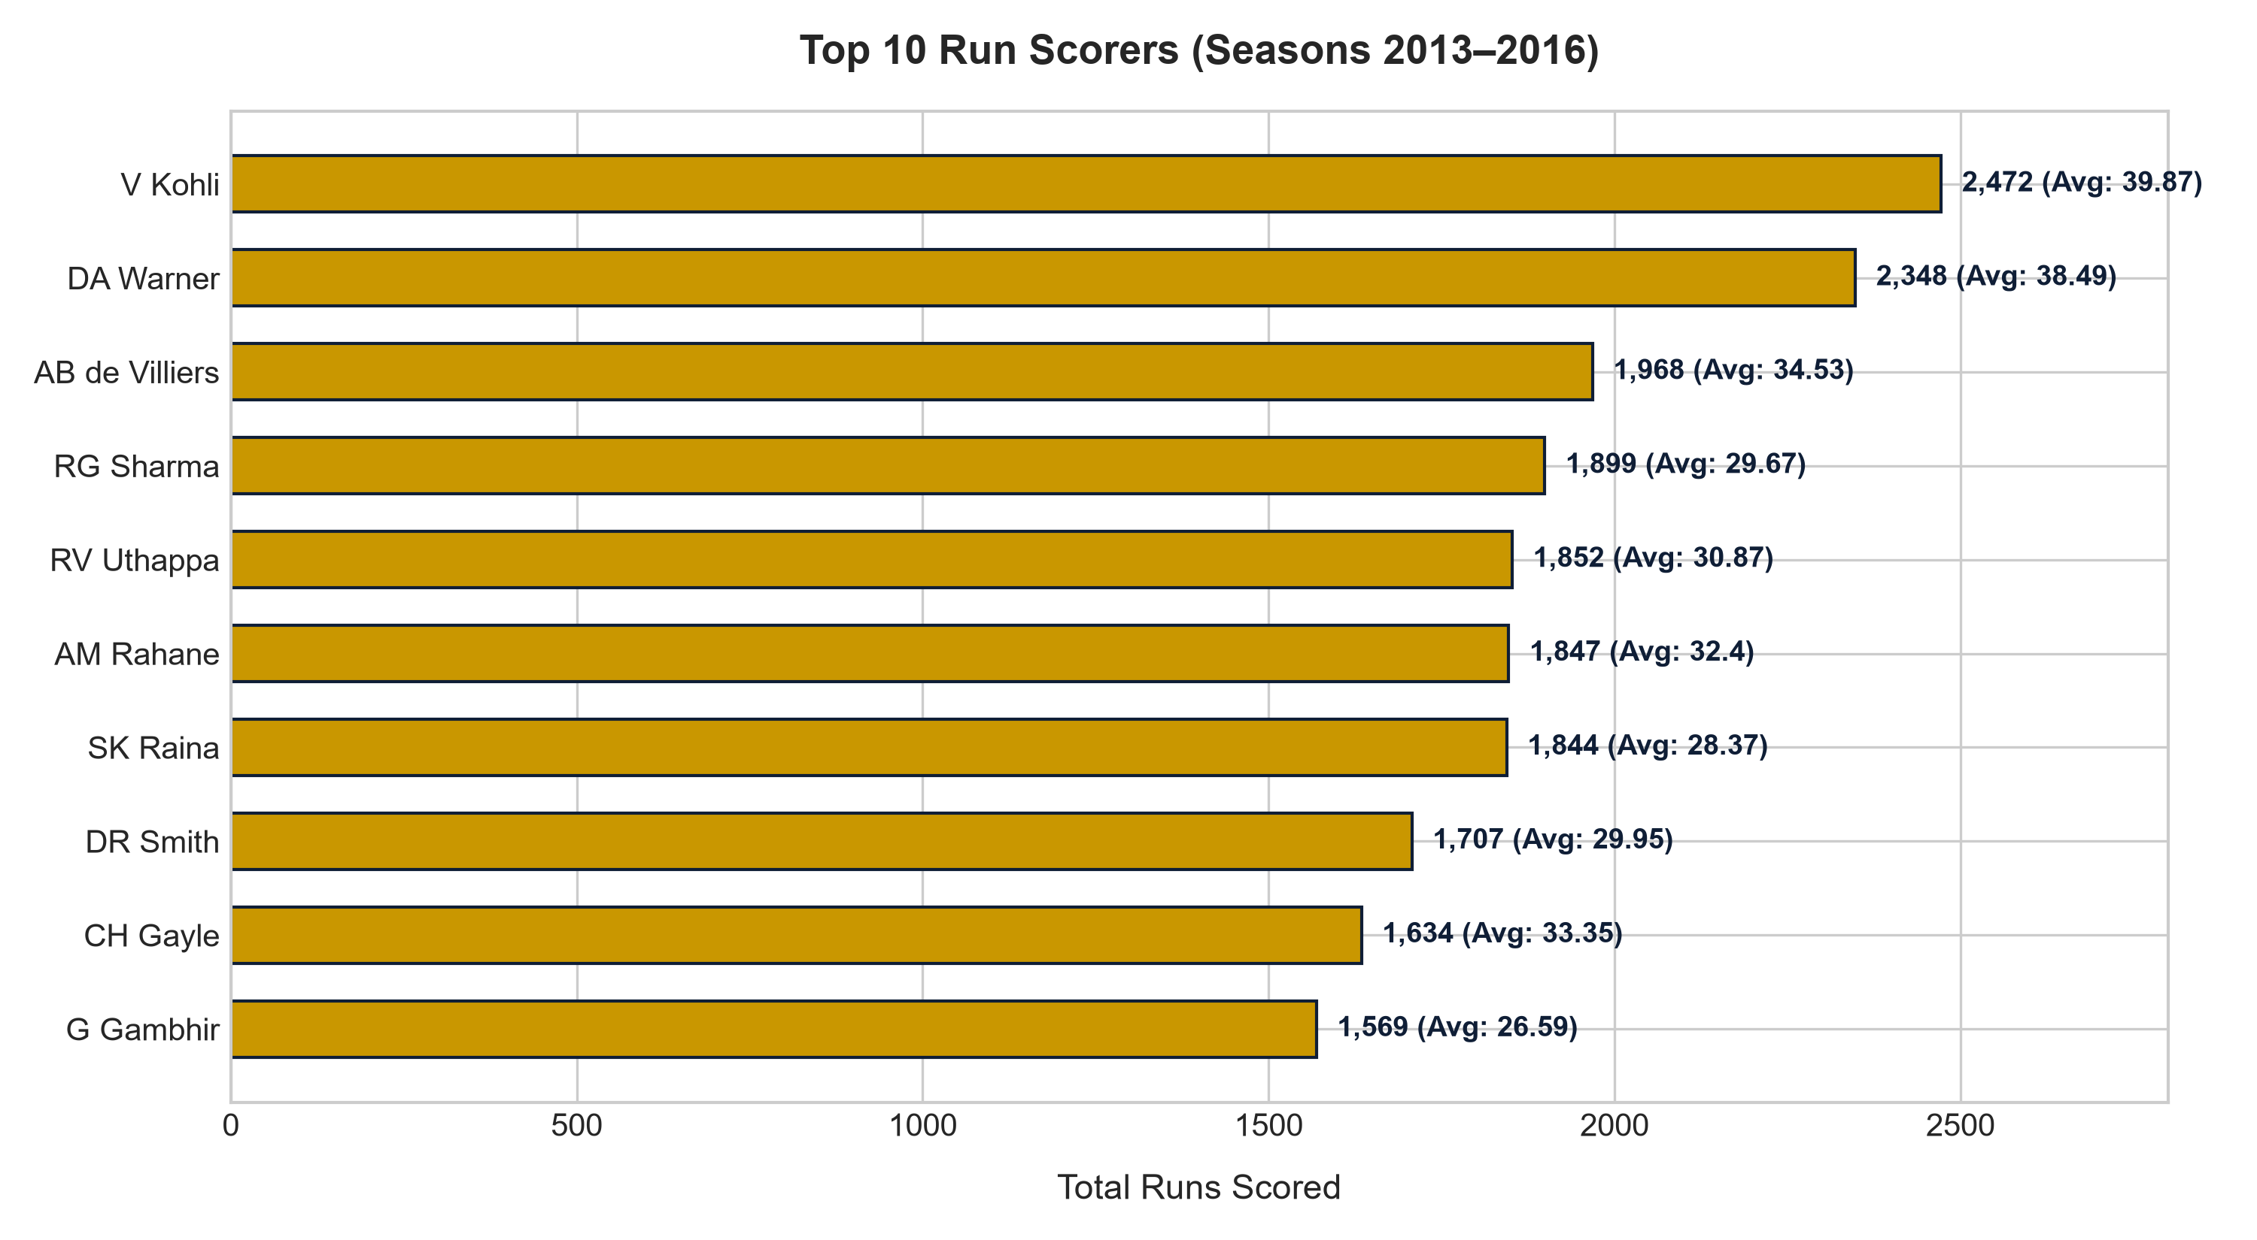
VOLUME RUN PRODUCTION
Top 10 Run Scorers (Seasons 2013–2016)
• Franchise Heavyweights Dominating Scoring
Virat Kohli leads all IPL run scorers with 2,472 runs in 62 matches (39.87 avg/match), followed by David Warner (2,348 runs in 61 matches, 38.49 avg/match).
• Concentration of Scoring Output
The top 3 run scorers account for over 6,700 runs, demonstrating the heavy reliance of franchises on top-order consistency.
• Auction Benchmark
Within the analyzed dataset, top-tier batting anchors consistently generate 450+ runs per season, indicating an essential benchmark for top-order recruitment and lineup stability.

Slide 7
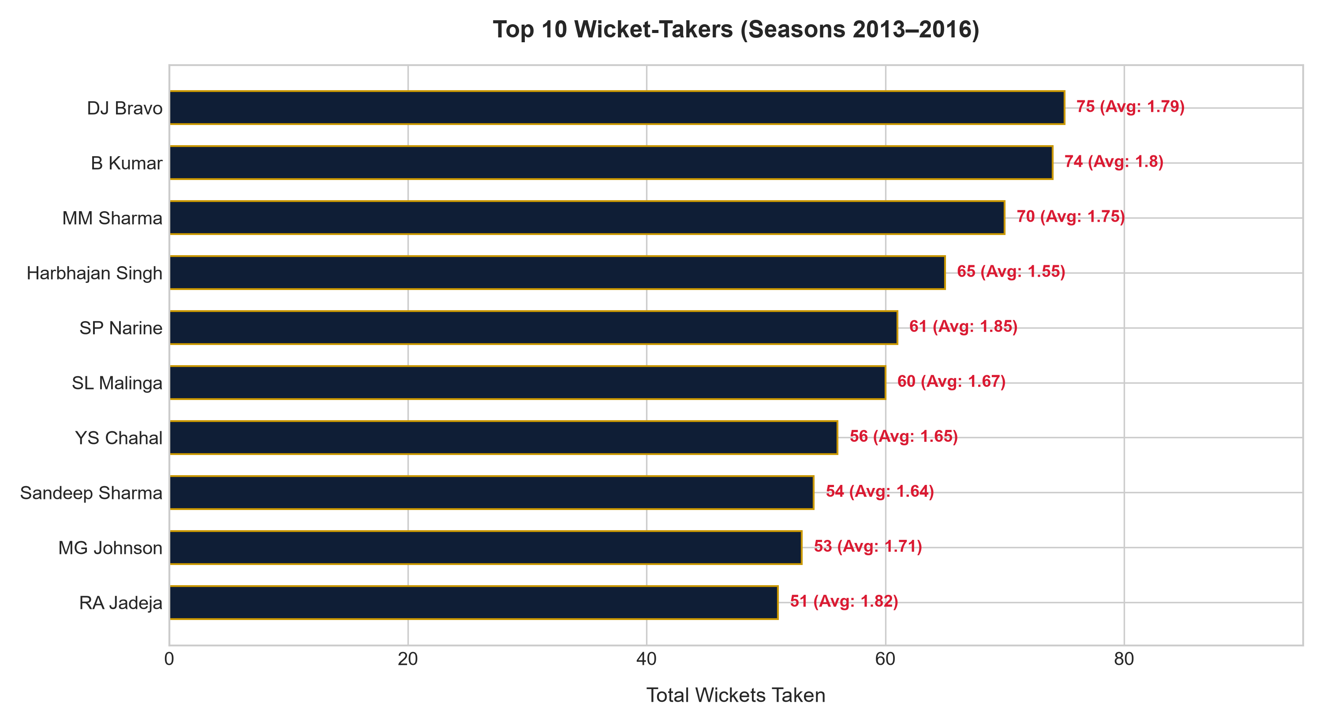
BOWLING PENETRATION METRICS
Top 10 Wicket-Takers (2013–2016)
• Pace Spearheads Leading Dismissals
Dwayne Bravo (75 wkts in 42 matches) and Bhuvneshwar Kumar (74 wkts in 41 matches) lead the tournament under official dismissal credit rules.
• Strike Frequency
Mohit Sharma (70 wkts in 40 matches) and Harbhajan Singh (65 wkts in 42 matches) average over 1.55 wickets per match, proving that wicket-taking breaks batting momentum.
• RCB Gap Analysis
Within the analyzed dataset, RCB lacked a top-5 tournament wicket taker, highlighting bowling penetration as a key area for squad-strengthening investigation.

Slide 8
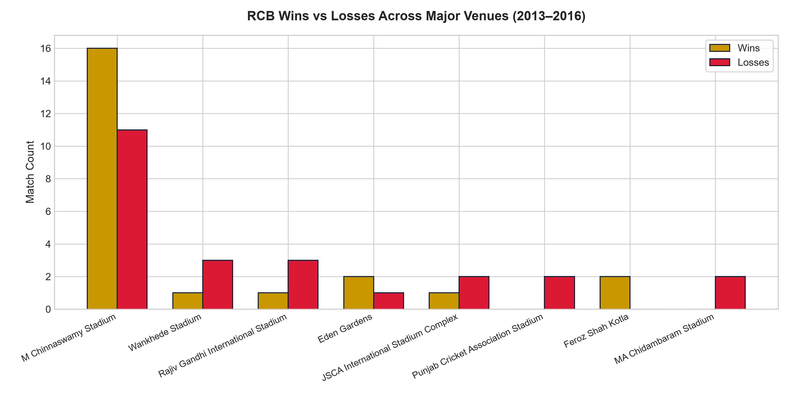
VENUE RECORD BREAKDOWN
RCB Wins vs Losses Across Major Stadiums
• Chinnaswamy Match Volume
RCB contested 27 completed matches at Chinnaswamy (2013–2016), winning 16 and losing 11 (59.26% win rate; 2 matches ended in No Result).
• Away Ground Polarization
Strong away conversions at Feroz Shah Kotla (2-0) and MCA Pune (2-0) contrast sharply with 0 wins at MA Chidambaram Chepauk (0-2).
• Tactical Alignment
Pitch conditions dictate outcomes; turning tracks require specialized defensive spin units that RCB historically under-indexed.

Slide 9
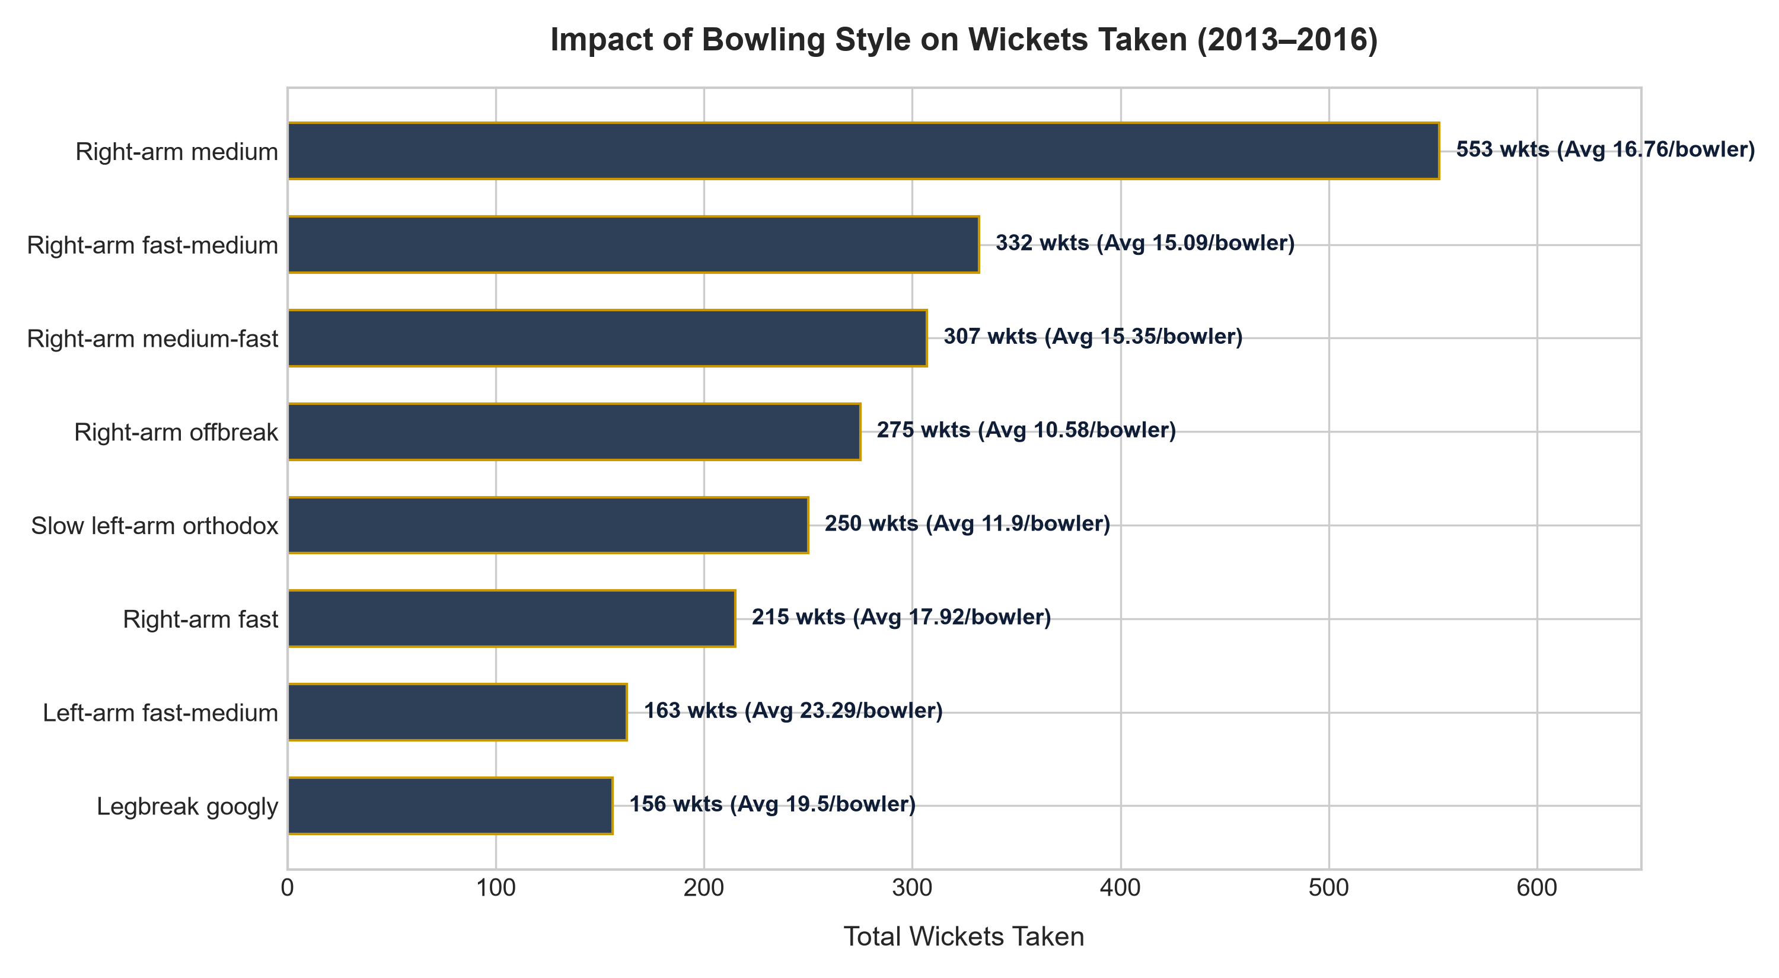
SKILL-BASED WICKET POTENCY
Bowling Style Impact on Wickets Taken
• Volume vs Strike Potency
Right-arm medium pacers bowl the highest volume (553 wkts across 33 bowlers, 16.76 wkts/bowler).
• Left-Arm Pace & Wrist Spin Superiority
Left-arm fast bowlers deliver the highest per-bowler impact (30.33 wkts/bowler), followed by Legbreak Googly spinners (19.50 wkts/bowler).
• Recruitment Priority
RCB must target left-arm seamers and wrist-spinners in the mega auction to create uncomfortable angles for opponents.

Slide 10
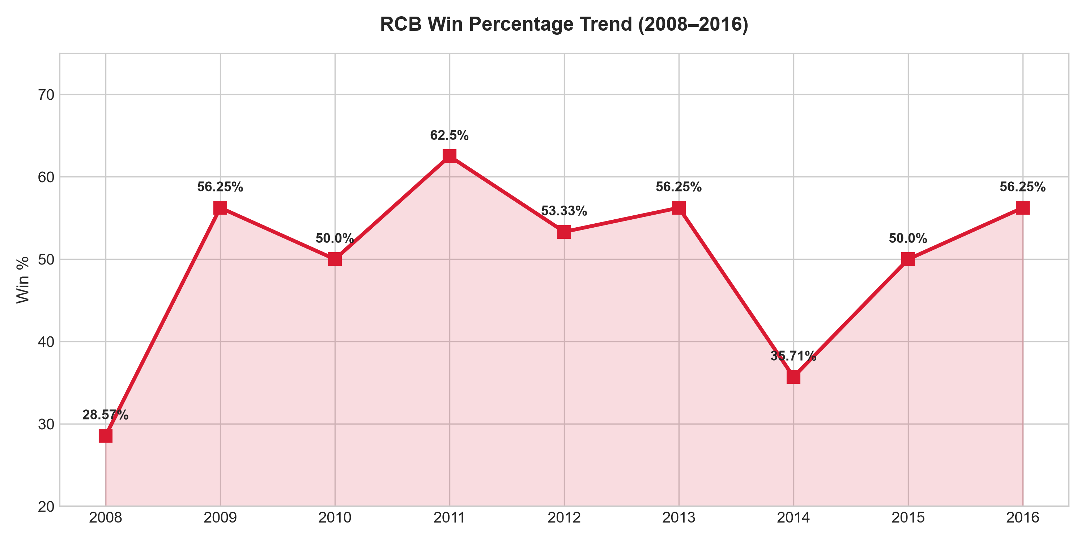
HISTORICAL WIN-LOSS VOLATILITY
RCB Season Win Percentage Trend (2008–2016)
• Performance Peaks and Historical Floor
RCB achieved its all-time tournament peak win rate of 62.50% in 2011 (10 wins, 6 losses in 16 matches), with secondary peaks at 56.25% in 2009, 2013, and 2016. The historical floor occurred in 2008 at 28.57% (4 wins, 10 losses in 14 matches), followed by 35.71% in 2014 (5 wins, 9 losses).
• High Volatility Index
RCB exhibits substantial seasonal win-rate swings across the nine seasons, driven by heavy reliance on individual batting spikes rather than consistent multi-phase bowling containment.
• Performance Benchmark
Sustained tournament qualification requires stabilizing regular-season win conversion above 60% while mitigating the multi-season volatility observed across the franchise's balance sheet.

Slide 11
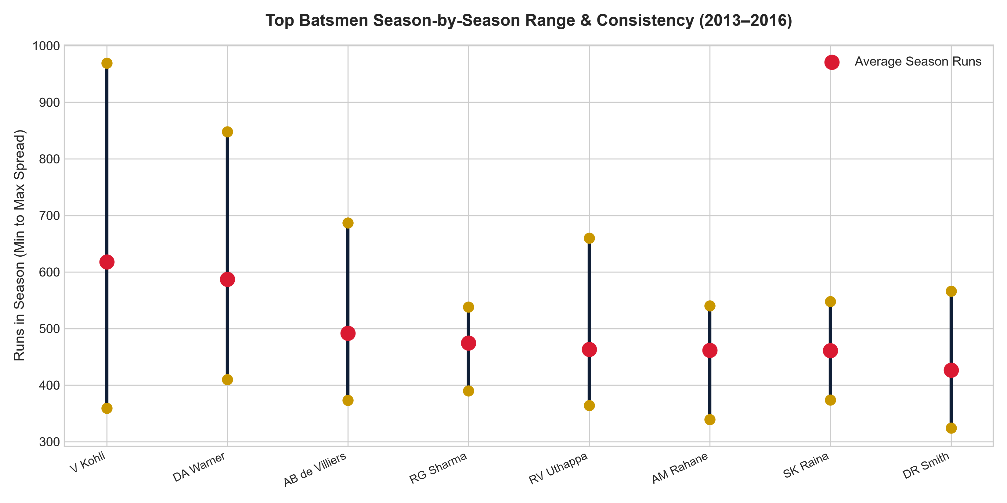
RELIABILITY & FLOOR ANALYSIS
Top Batsmen Seasonal Spread & Consistency
• Ceiling vs Floor Comparison
David Warner (587.0 avg, worst season: 410, best: 848) and Ajinkya Rahane demonstrate the lowest variance and highest floor in the tournament.
• Kohli's Peak Dispersion
Within the analyzed dataset, Virat Kohli's 2016 campaign generated the highest individual seasonal tally (969 runs), contrasted with a floor of 359 runs in 2014.
• Squad Construction Rule
Pairing volatile power-hitters with high-floor anchors ensures stability during top-order collapses.

Slide 12
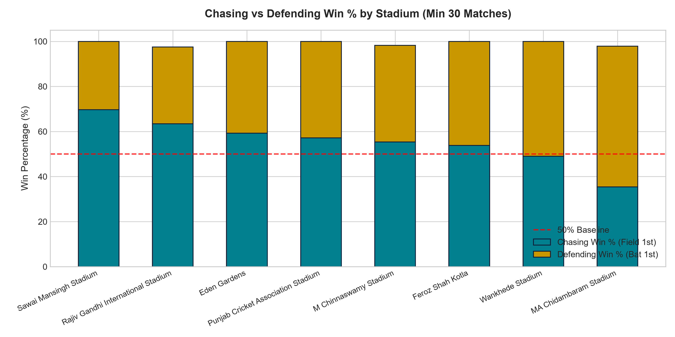
TOSS & VENUE DYNAMICS
Chasing vs Defending Win % by Stadium
• Chasing Dominance at Dew Grounds
Chasing confers massive advantages at Sawai Mansingh (69.70%), Rajiv Gandhi Uppal (63.41%), and Eden Gardens (59.26%).
• Defending Fortress at Chepauk
Chepauk is the stark exception, where batting first wins 64.58% of games as the dry clay pitch slows down drastically.
• Venue-Conditional Toss Strategy
Chasing win rates differ substantially by ground: while dew-heavy venues strongly reward bowling first, Chepauk favors batting first (64.58% defending). Toss strategy must be conditionally tailored to individual venue conditions rather than governed by a blanket league-wide assumption.

Slide 13
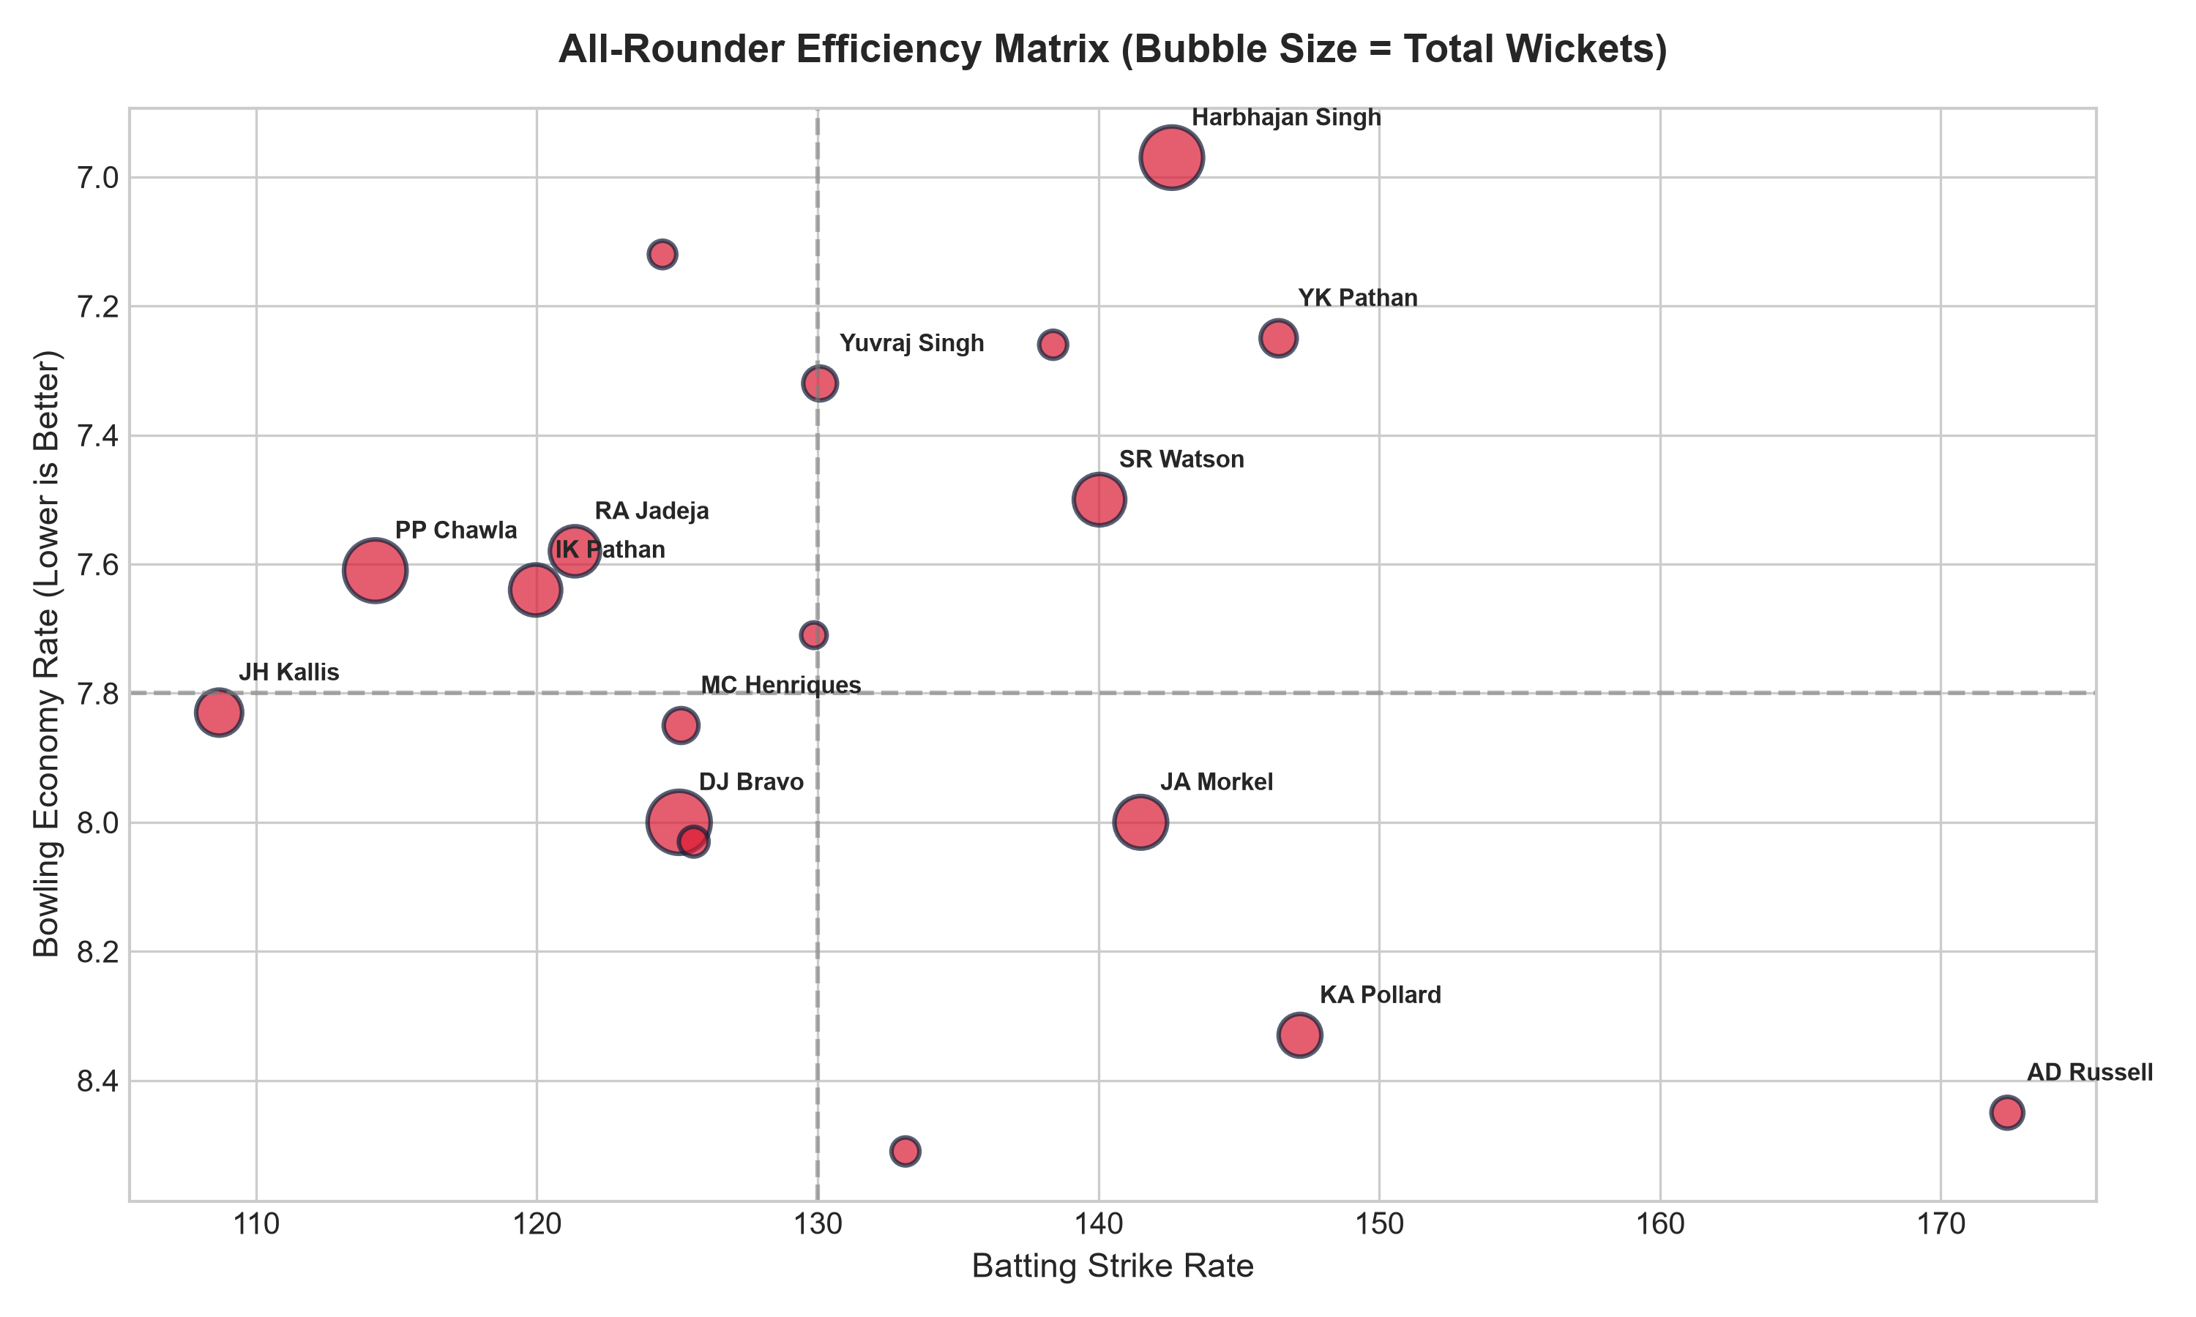
DUAL-THREAT ASSET VALUATION
All-Rounder 2D Efficiency Matrix
• Project-Defined Versatility Index
Versatility is evaluated via the project-defined analytical heuristic (total_runs * total_wickets) / 100 (min 500 runs, min 20 wickets). This is a custom analytical metric designed to evaluate multi-discipline volume, not an official cricket statistic.
• Top 10 All-Rounder Profiles
Top 10 all-rounders: (1) SR Watson (2067.93 index | 2,553 runs, 81 wkts), (2) JH Kallis (1577.55 | 2,427 runs, 65 wkts), (3) DJ Bravo (1539.64 | 1,262 runs, 122 wkts), (4) RA Jadeja (1211.98 | 1,574 runs, 77 wkts), (5) YK Pathan (1111.60 | 2,779 runs, 40 wkts), (6) KA Pollard (1097.04 | 1,959 runs, 56 wkts), (7) SK Raina (985.44 | 4,106 runs, 24 wkts), (8) Harbhajan Singh (931.77 | 783 runs, 119 wkts), (9) IK Pathan (918.40 | 1,148 runs, 80 wkts), and (10) JA Morkel (828.75 | 975 runs, 85 wkts).
• Squad Construction Priority
High-leverage dual-threat contributors provide vital batting depth and bowling overs, balancing high-order stroke play with bowling flexibility to protect RCB's lower-middle order.

Slide 14
INDIVIDUAL MATCH IMPACT & TEAM PILLARS (S5)
Man of the Match Awards & RCB Win-Rate Consistency
Analysis 1: League-Wide Match-Winners (Top 10 MoMs)
Analysis 2: RCB Core Pillars (Min 20 Matches, Top 10 Win %)
Player_Name | mom_awards | seasons_awarded
CH Gayle | 17 | 5
YK Pathan | 16 | 8
AB de Villiers | 15 | 7
DA Warner | 14 | 7
SK Raina | 13 | 9
RG Sharma | 13 | 7
MEK Hussey | 12 | 5
MS Dhoni | 12 | 8
G Gambhir | 12 | 7
AM Rahane | 12 | 5
Player_Name | matches | rcb_wins | rcb_win_pct
TM Dilshan | 24 | 16 | 66.67%
S Aravind | 28 | 17 | 60.71%
SS Tiwary | 39 | 22 | 56.41%
CH Gayle | 75 | 42 | 56.00%
MV Boucher | 27 | 15 | 55.56%
DL Vettori | 22 | 12 | 54.55%
HV Patel | 34 | 18 | 52.94%
AB de Villiers | 91 | 48 | 52.75%
M Muralitharan | 21 | 11 | 52.38%
RV Uthappa | 31 | 16 | 51.61%
• Analysis 1 (Match Impact): Chris Gayle (17 MoMs, #1) and AB de Villiers (15 MoMs, #3) lead in individual match-winning knocks. Man-of-the-Match awards provide an observable measure of individual match impact, although they do not by themselves establish a causal effect on team morale or win probability.
• Analysis 2 (Core Pillars): TM Dilshan (66.67%) and S Aravind (60.71%) record the highest win percentages for RCB (min 20 matches), followed by SS Tiwary (56.41%), CH Gayle (56.00%, 42 wins in 75 matches), and AB de Villiers (52.75%, 48 wins in 91 matches), demonstrating player appearance consistency.

Slide 15
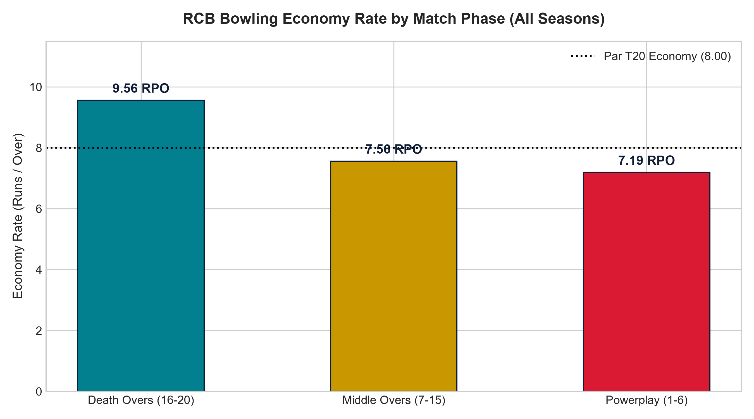
PHASE-WISE LEAKAGE DIAGNOSIS
RCB Bowling Economy Rate by Match Phase
• The Death Overs Calamity
RCB concedes an alarming 9.56 runs per over in the Death Phase (overs 16–20), leaking 5,890 runs.
• Powerplay & Middle Overs Parity
Powerplay (7.19 RPO) and Middle Overs (7.56 RPO) remain controlled, identifying the death-overs phase (9.56 RPO) as the primary area of defensive run leakage.
• Actionable Remedy
RCB must acquire specialized yorker executioners and change-of-pace masters to bring death economy under 8.50 RPO.

Slide 16
HIGH-SCORING VENUES & SCORING DYNAMICS (S7)
Venue Scoring Benchmarks, Boundary Reliance & Broadcast Analysis
Venue Scoring & Boundary Percentage Benchmark (Min 10 Matches)
• Scoring Velocity Dynamics
Brabourne Stadium recorded the highest average match total (349.18 runs) among grounds hosting >=10 matches, while M Chinnaswamy Stadium recorded the highest boundary-run share (60.46% of all runs from 4s and 6s) in the result set.
• Bowling Tactical Preparation
Venues with extreme boundary reliance demand tactical discipline: pace variation, wide yorkers, and hard lengths to suppress boundary volume, rather than relying on standard lengths.
• Viewership Impact Disclosure
Viewership impact cannot be measured directly from the provided IPL database because the dataset does not contain television ratings (TRPs), streaming views, or social-engagement data.
Venue_Name | matches | avg_runs | max_runs | boundary_pct
Brabourne Stadium | 11 | 349.18 | 420 | 54.78%
MA Chidambaram Stadium, Chepauk | 48 | 318.27 | 469 | 51.84%
M Chinnaswamy Stadium | 58 | 317.93 | 473 | 60.46%
Wankhede Stadium | 49 | 315.65 | 459 | 57.65%
Eden Gardens | 54 | 309.28 | 400 | 50.81%

Slide 17
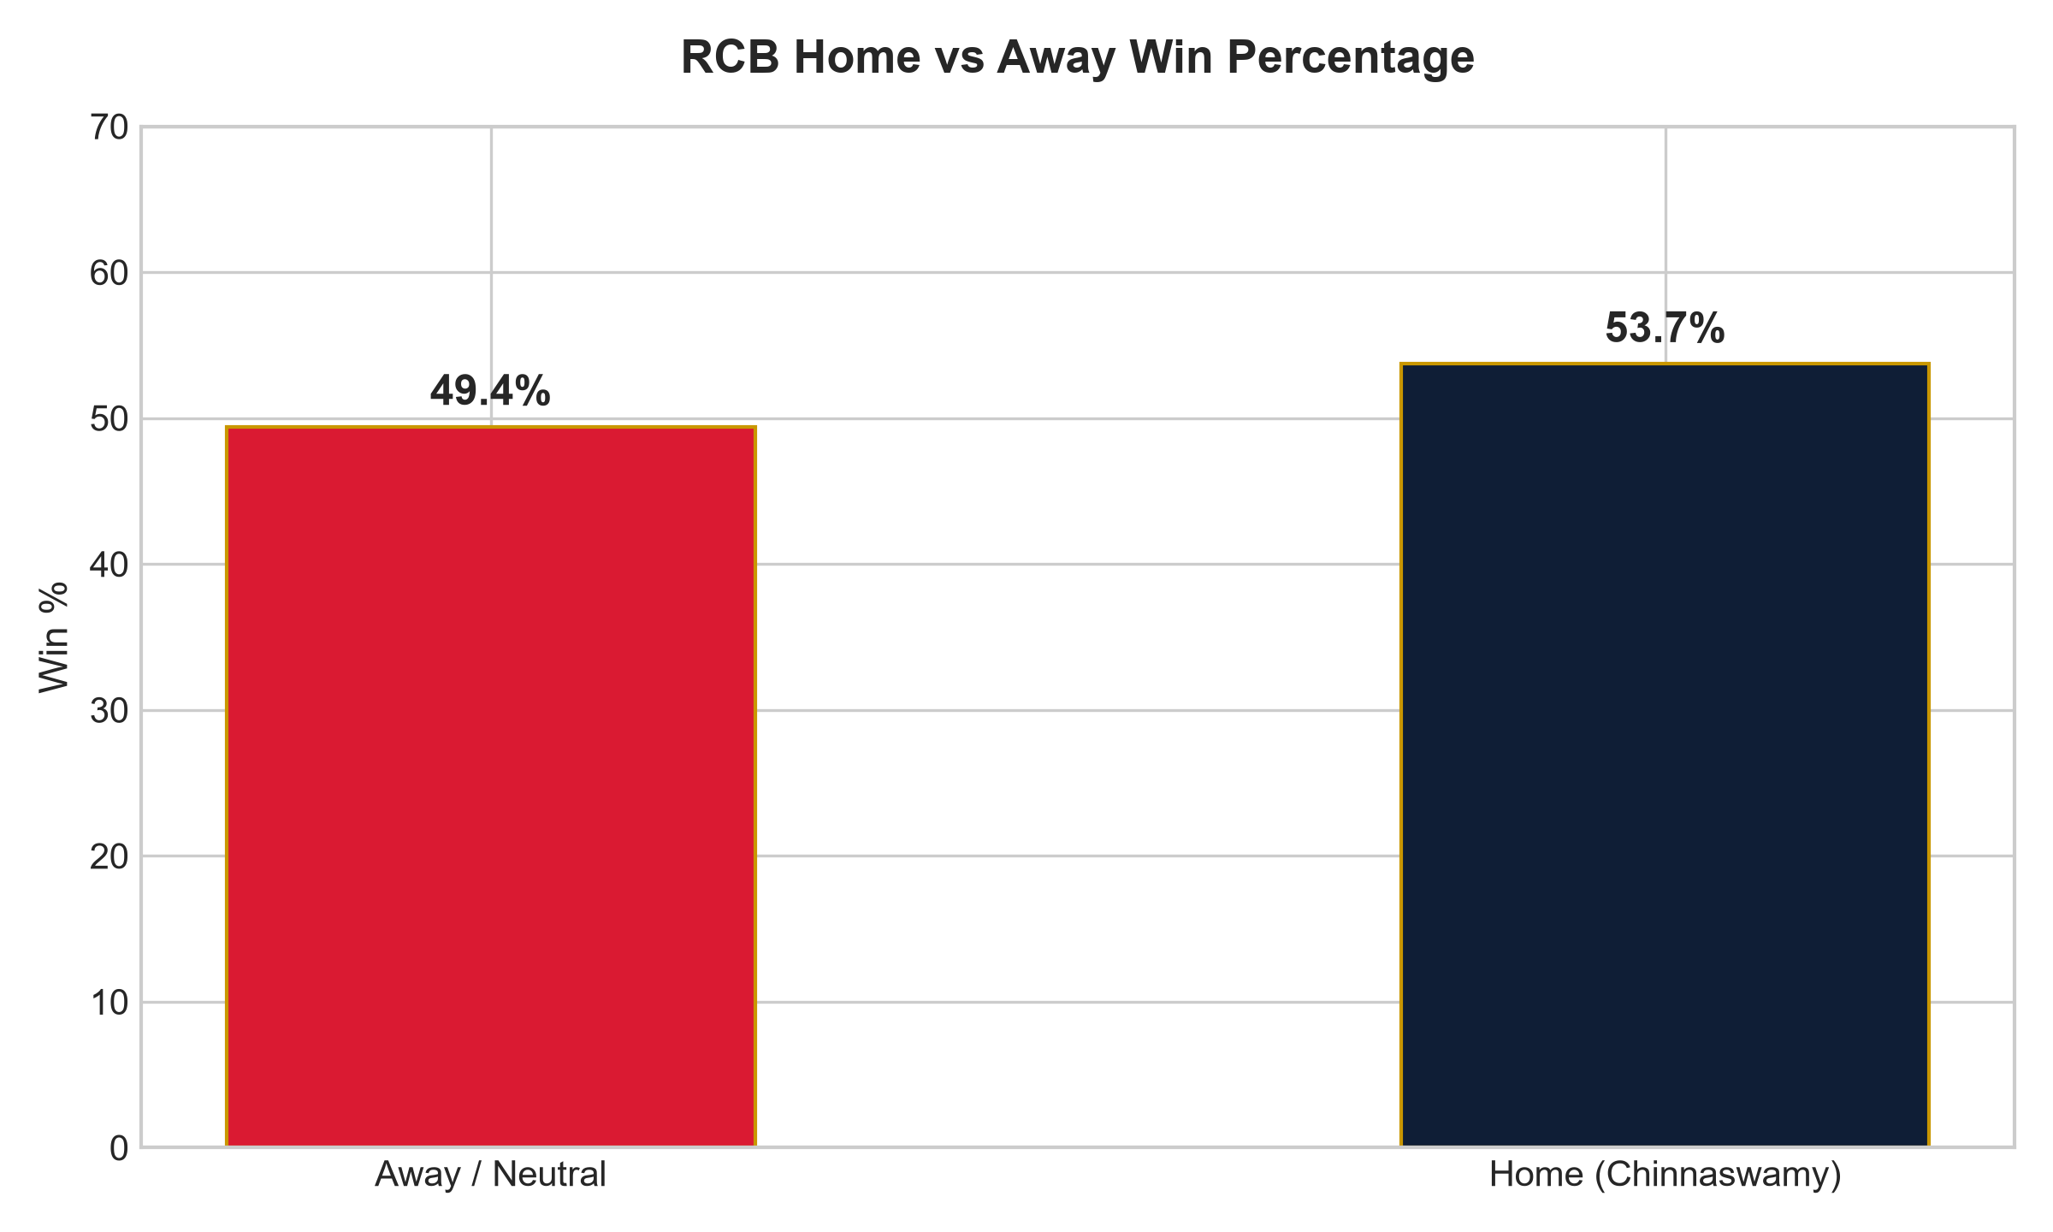
FORTRESS CONVERSION GAP
RCB Home vs Away Win Percentage
• Home vs. Away/Neutral Record
RCB recorded a 53.70% win percentage at M Chinnaswamy Stadium (29 wins, 25 losses in 54 completed matches) compared to 49.40% at away/neutral venues (41 wins, 42 losses in 83 completed matches).
• Home Ground Reality
While Chinnaswamy provides a modest positive differential (+4.30 percentage points), home advantage alone is insufficient to secure positive outcomes, requiring tactical adjustments tailored to the venue's scoring dynamics.
• Ground Maximization Strategy
Chinnaswamy's short boundaries require defensive disciplines—pace-off deliveries, cutters, and disciplined lengths—rather than relying on express pace alone.

Slide 18
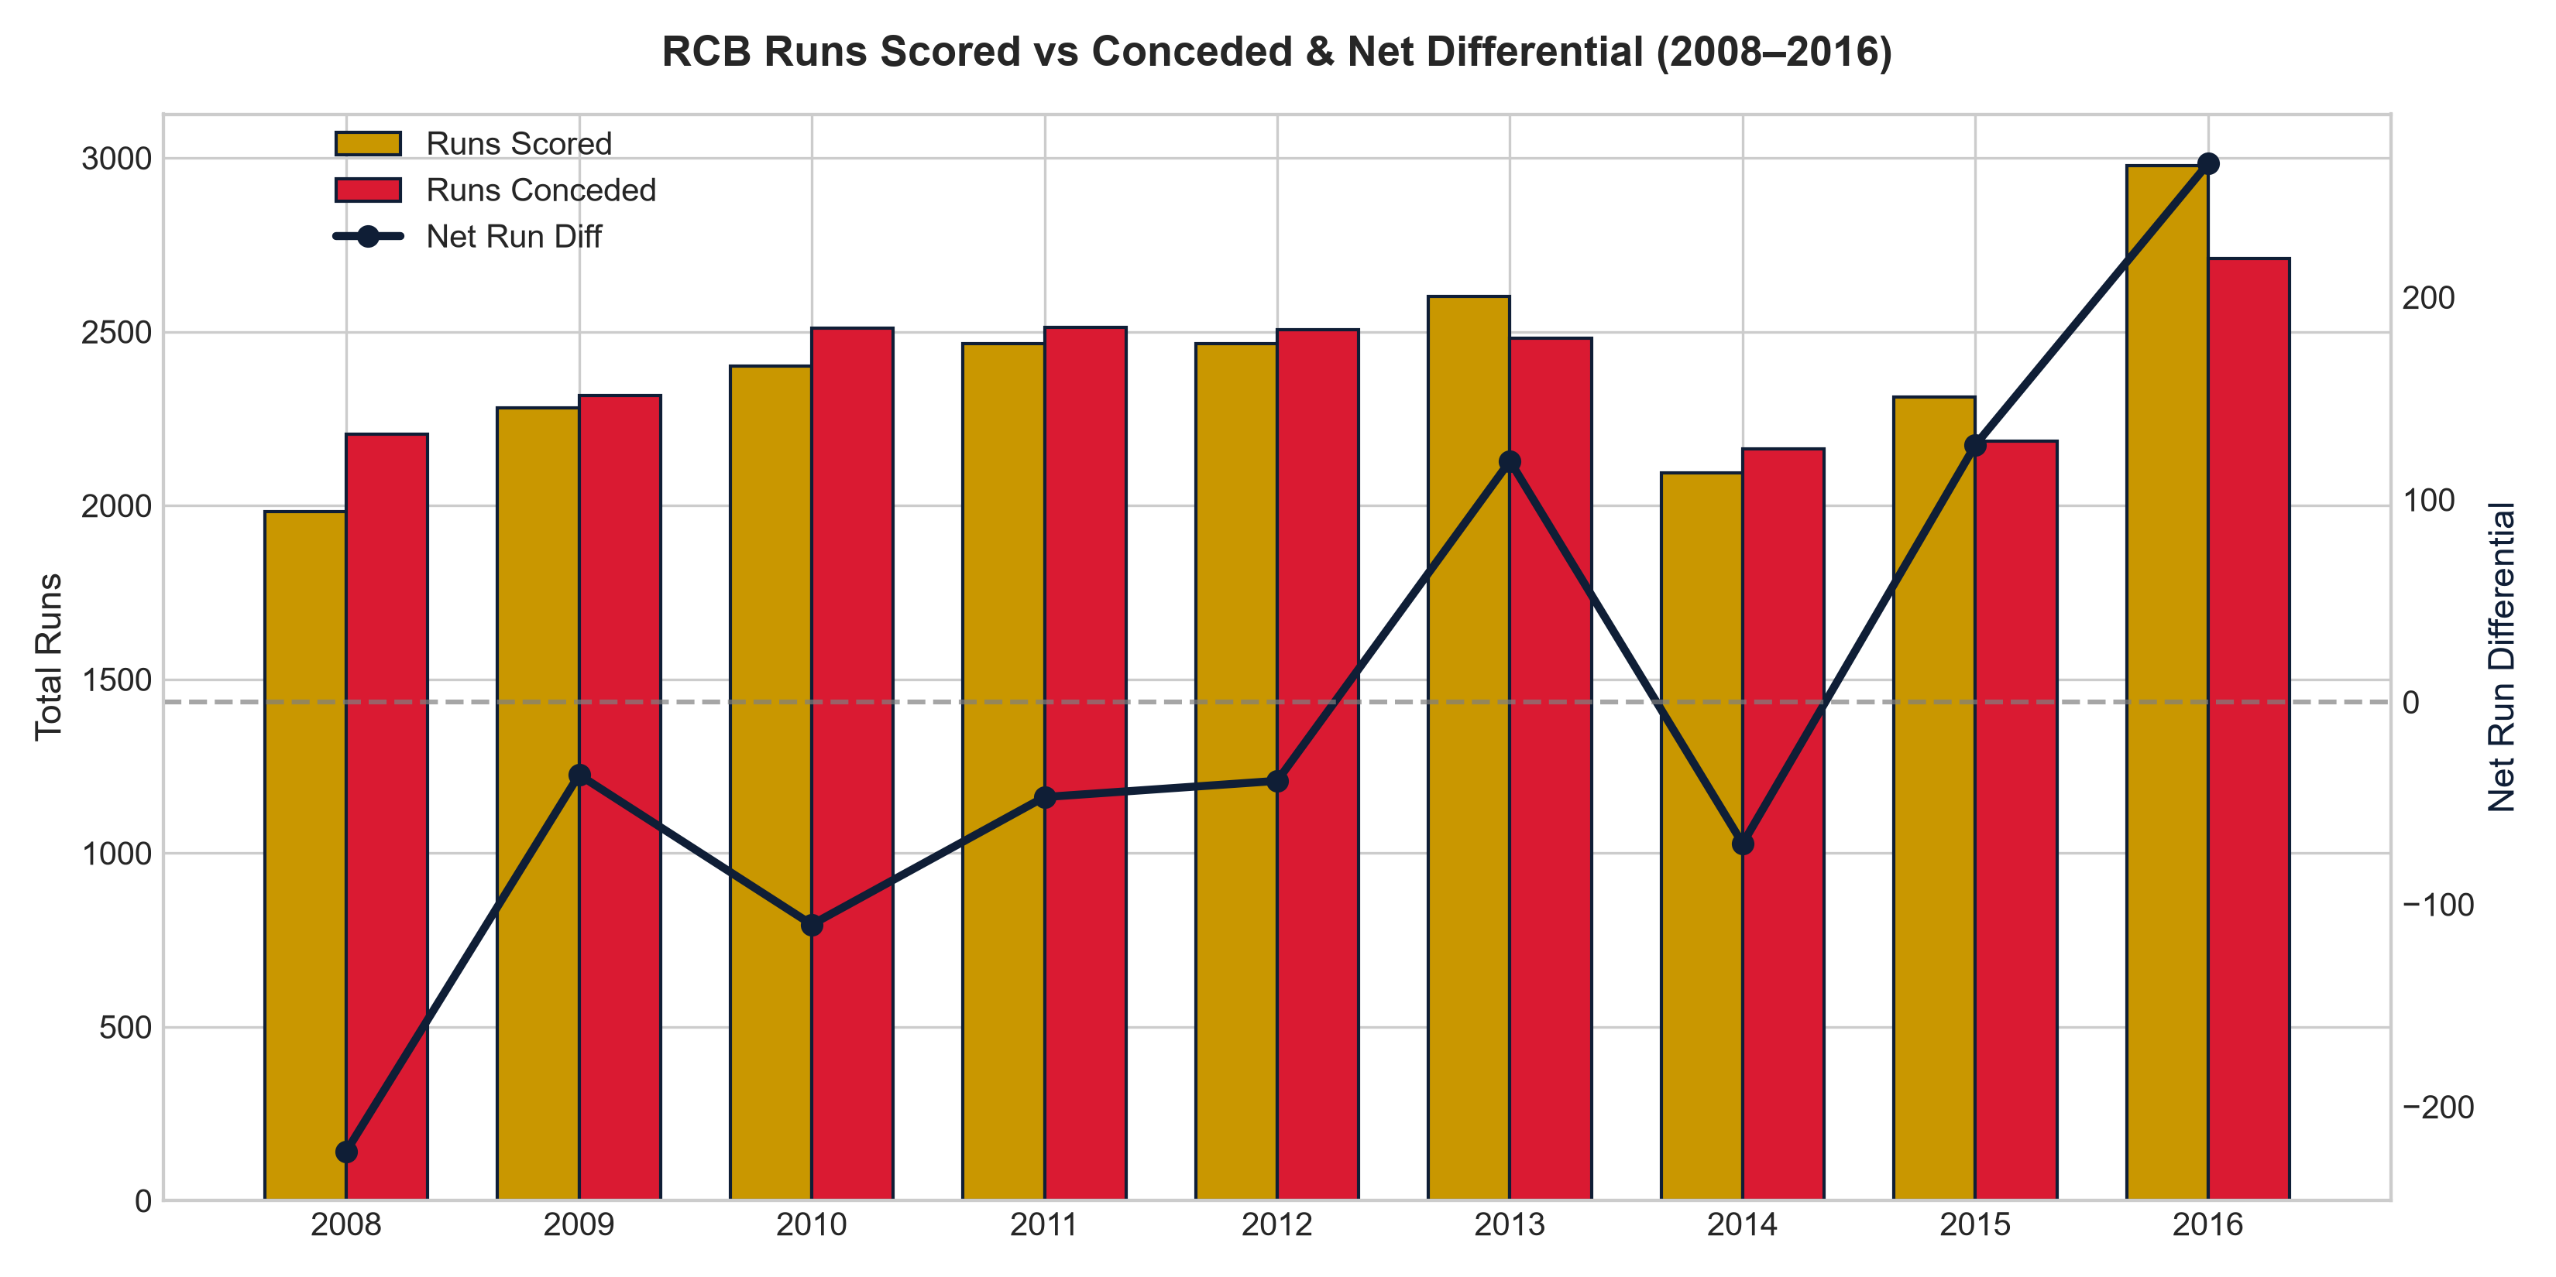
SEASON BALANCE SHEET & RUN DIFFERENTIAL ANALYSIS
RCB Historical Scoring vs Conceding Dynamics (2008–2016)
• Season Run Differential Trends
In 6 of 9 seasons (2008, 2009, 2010, 2011, 2012, 2014), RCB recorded a negative net run differential, conceding more runs than they scored. Positive net differentials occurred in 2013 (+180), 2015 (+120), and 2016 (+266), coinciding with deep playoff runs.
• 2016 High-Scoring Campaign
In 2016, RCB scored 2,977 runs while conceding 2,711 runs (+266 differential) and took 89 wickets across 16 matches, culminating in the 2016 IPL final appearance.
• Analytical Finding
The season-level balance sheet identifies run prevention and bowling performance as consistent areas for strategic attention, though the SQL analysis alone does not establish a single causal explanation for the absence of a trophy.

Slide 19
STRATEGIC ANALYTICAL FRAMEWORK & FUTURE WORK (S10)
Empirical Whole-Match Diagnostic & Advanced Modeling Roadmap
1. Completed Baseline Diagnostic (SQL S10)
The SQL query establishes a complete franchise balance sheet across all 139 matches played by RCB:
• Total Matches Analyzed: 139
• All-Time Win Rate: 50.72% (70 wins, 67 losses, 2 NR)
• Average Runs Scored / Match: 152.01 runs
• Average Runs Conceded / Match: 146.65 runs
• Net Scoring Margin: +5.36 runs per match
• Strategic Interpretation
Across 9 seasons, RCB maintained a positive average run margin (+5.36 runs/match). The analysis indicates that season-level volatility, death-overs run leakage, and knockout match variance contributed to tournament elimination.
2. Potential Next-Step Analysis (Future Work)
• Runs Above Average (RAA):
Advanced player valuation model to isolate individual batting contributions above league replacement levels, normalized for match phase and venue scoring benchmarks.
• Wickets Above Expected (WAE):
Context-dependent bowling metric evaluating dismissal probability per delivery conditioned on batsman quality and phase par.
• Auction Portfolio Optimization (Linear Programming):
Mathematical optimization model to allocate auction budget across required player archetypes under purse caps.
• Methodological Classification:
These advanced models represent proposed next-step analytical extensions and future research directions rather than completed database outputs in the current analysis.

Slide 20
STRATEGIC DIRECTIVE
Tactical & Squad Rebalancing Recommendations
1. Phase-Specific Bowling Overhaul (The Death-Overs Imperative)
RCB's #1 priority is capping the 9.56 death overs economy. Target specialized pace bowlers who can execute wide-line yorkers, slower bouncers, and knuckleballs under high pressure.
2. Venue-Specific Tactical & Pitch Calibration
Align toss and fielding tactics conditionally with ground-specific scoring environments (evaluating dew-favored chasing venues separately from defensive spin tracks like Chepauk). Home ground preparation should emphasize pitch characteristics that assist bowling control and containment without assuming home ground alone dictates positive outcomes.
3. De-Risking Top-Order Dependency
Virat Kohli, Chris Gayle, and AB de Villiers produce over 70% of batting runs. Recruit dependable numbers 4 and 5 batsmen who excel against spin to prevent catastrophic collapses when early wickets fall.

Slide 21
STRATEGIC CONCLUSION & PURSE STRATEGY
2017 Mega Auction War-Room Allocation Blueprint
1. Dynamic Auction Resource Allocation
The high death-overs economy (9.56 RPO) identifies death bowling and squad balance as critical areas for squad-strengthening consideration. Auction allocation should be evaluated dynamically using player market cost, role coverage, availability, and projected contribution rather than a fixed percentage derived from database queries alone.
2. Data-Driven Matchups & Scouting
Utilize predictive strike-rate splits (Spin vs Pace) and venue efficiency metrics to identify undervalued assets before rival franchises drive up price tags.
3. Core Retention Mandate
Retain Virat Kohli and AB de Villiers as core franchise pillars, building dedicated death-bowling depth around them.

